Slide 1
Machine Learning for Search
WELCOME!
Axel Sirota
AI Consultant
Notes:
[Mandatory Slide]
ACTION: Adjust title, name, info, etc.

Slide 2

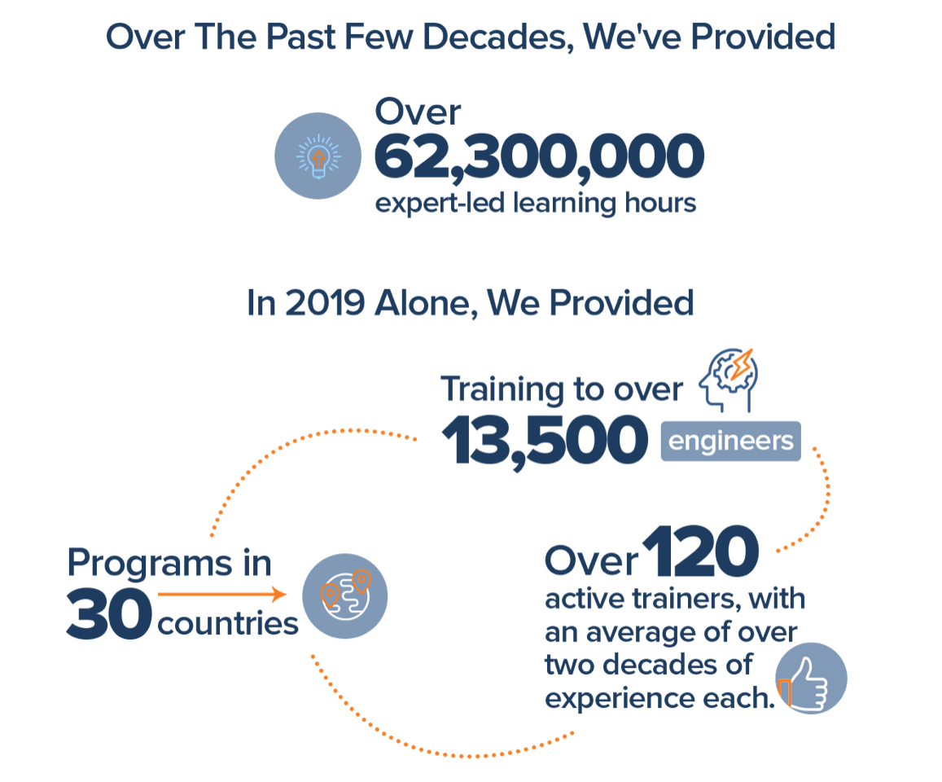
Join Us in Making Learning Technology Easier
Our mission…
Over 16 years ago, we embarked on a journey to improve the world by making learning technology easy and accessible to everyone.
…impacts everyone daily.
And it’s working. Today, we’re known for delivering customized tech learning programs that drive innovation and transform organizations. In fact, when you talk on the phone, watch a movie, connect with friends on social media, drive a car, fly on a plane, shop online, and order a latte with your mobile app, you are experiencing the impact of our solutions.
Copyright DevelopIntelligence LLC
Notes:
[Mandatory Slide]
ACTION: Share a bit about DevelopIntelligence
- As developers you want to learn!
- As a corporation you want your developers to align their learning with your business goals.
- That’s where we come in… Keeping developers current, bringing others up-to-speed … all aimed at moving your business forward!
- DI was started in 2003 by a Sun Microsystems developer that wanted to help developers level-up and see business better leverage IT

Slide 3
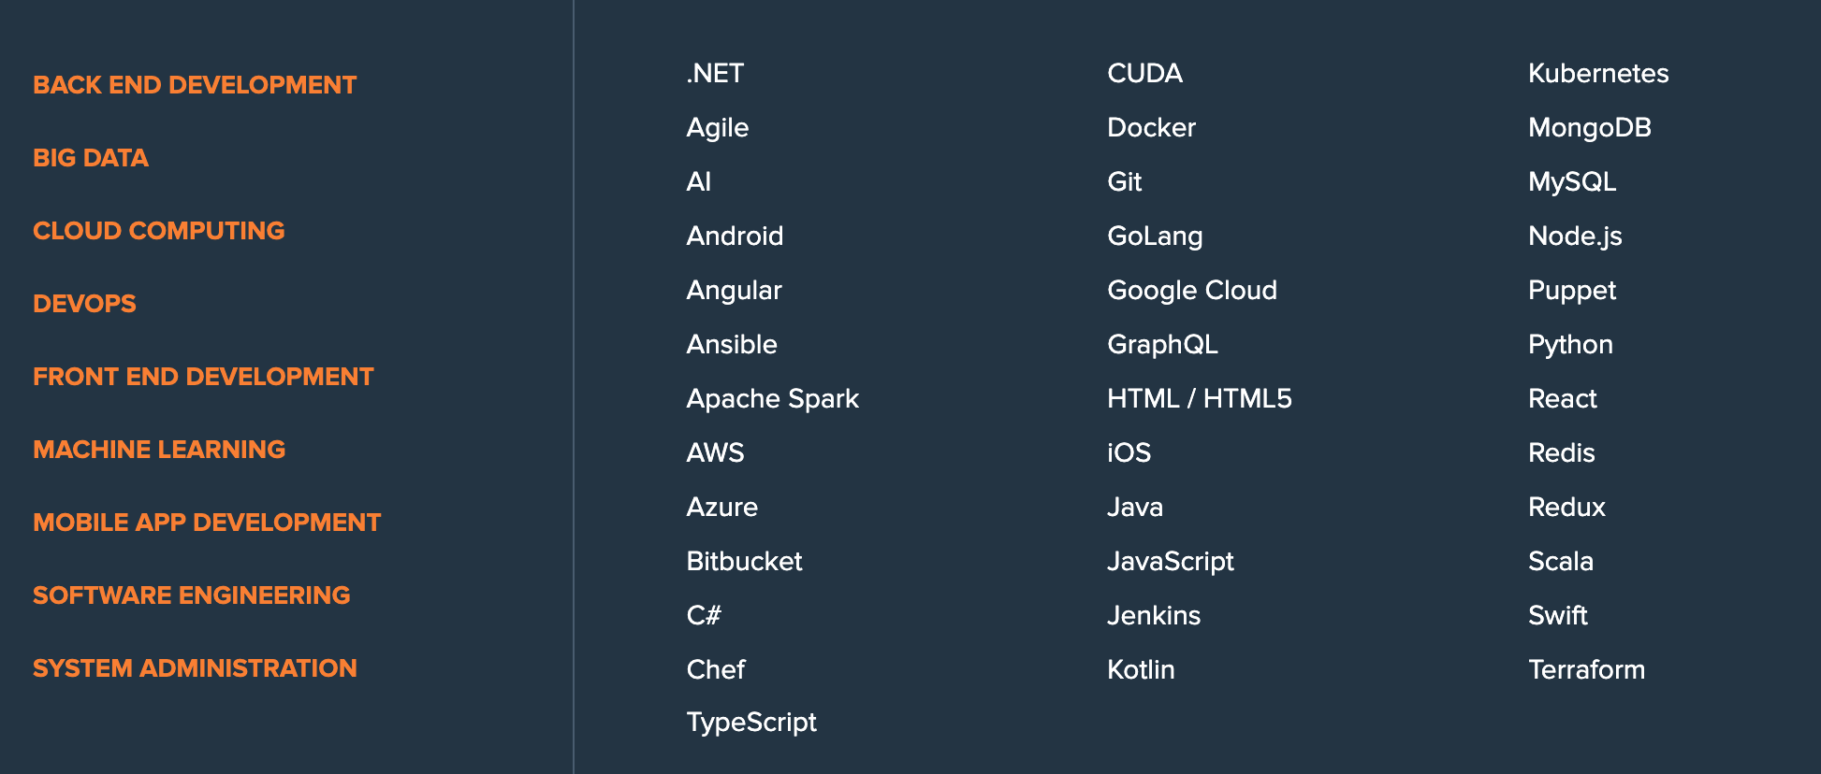

Upskilling and Reskilling Offerings
Intimately customized learning experiences just for your teams.
Workshop
2-3 day upskilling experiences
Fast Track
5-day reskilling experiences
Learning Spike
1-day technology overviews
Target Topics
90-minute instructor-led micro-learnings
Hack-a-thon
Learn and build an MVP in 2-3 days
Notes:
[Mandatory Slide]
ACTION: Share some of the technologies we teach
Areas of DevelopIntelligence expertise
DevOps: Ansible / Jenkins
BigData: Hadoop / Cassandra / Spark
Machine Learning
Front-end: React / Angular
Cloud: AWS / Azure / Google Cloud
- Started as a Java shop -> kept growing -> haven’t looked back
- Our specialty is hiring expert practitioners that can come alongside teams and teach them how to move forward

Slide 4
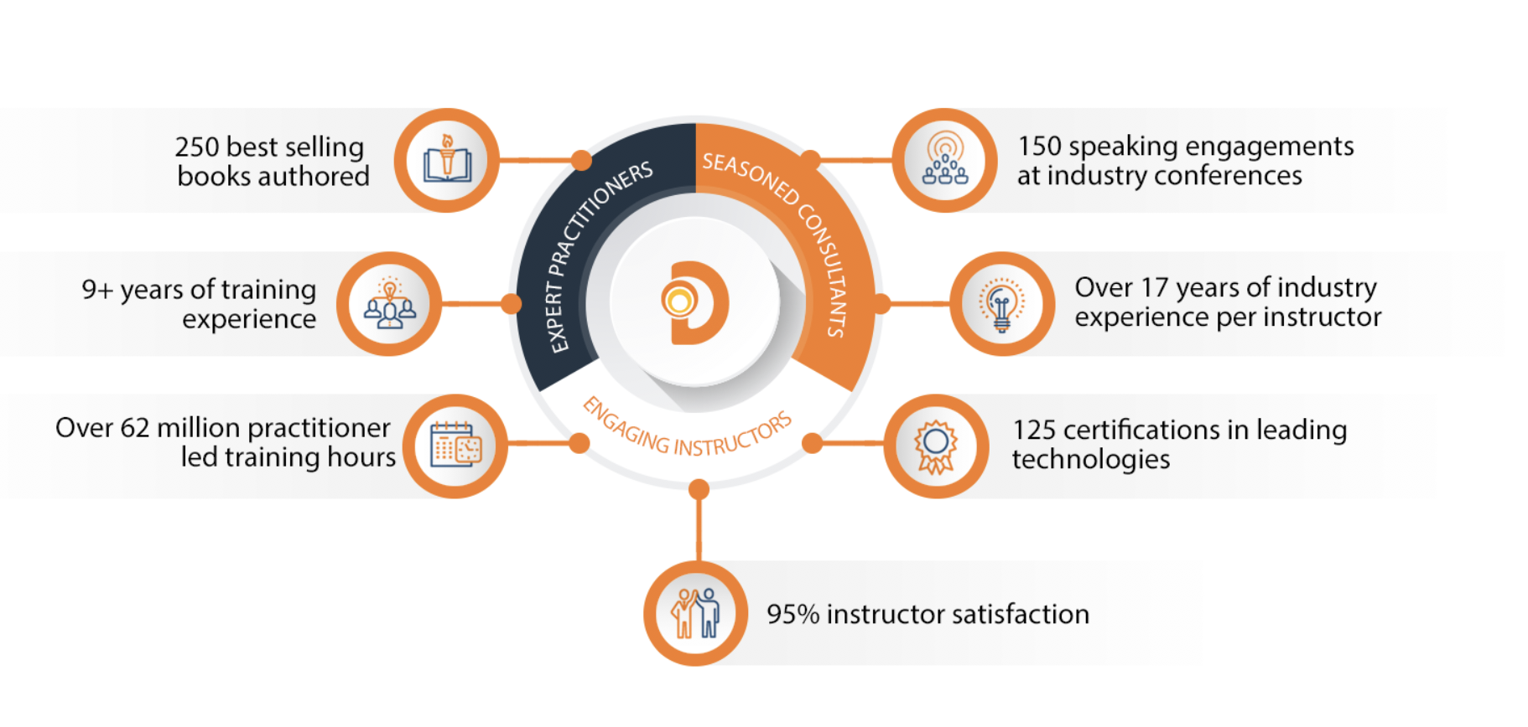
World Class Practitioners
Notes:
[Mandatory Slide]
ACTION: Share about what makes the DevelopIntelligence instructor team one of-a-kind!
Here is some data showing instructors are expert practitioners, engaging instructors, seasoned consultants. We are the best in the business!

Slide 5
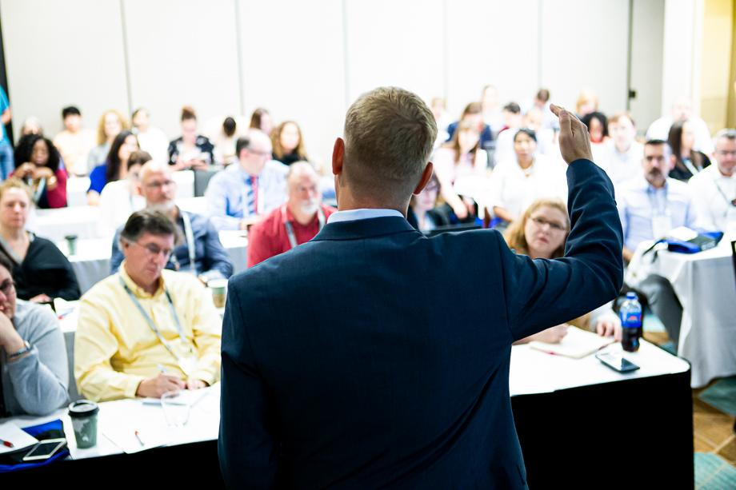


Note About Virtual Trainings
What we want ...what we’ve got
Notes:
[Mandatory slide for virtual courses]
Obviously, when in person, remove this and the following slides about virtual trainings
ACTION: Share about the modality we are currently using
It is good to call the elephant out in the room. Everyone would prefer to be on-site together. That is not going to happen for this class, so let’s dig in, be interactive and have fun!
In a classroom, it’s easy to see your faces and know if topics are understood–be sure to let me know if anything is unclear!

Slide 6



Virtual Training Expectations for You
Arrive on time / return on time Mute unless speaking Use chat or ask
questions verbally
Notes:
[Mandatory slide for virtual courses]
Obviously, when in person, remove this and the following slides about virtual trainings
ACTION: Share the expectations you have for the students
Level set the rules of engagement for virtual classrooms. Encourage students to be on time! Just because this is a virtual class doesn’t mean it’s ok to inconvenience peers who showed up on time.
Mute yourself unless asking a question/commenting
Ask questions (verbally or via chat window)

Slide 7
Virtual Training Expectations for Me
I pledge to:
Make this as interesting and interactive as possible
Ask questions in order to stimulate discussion
Use whatever resources I have at hand to explain the material
Try my best to manage verbal responses so that everyone who wants to speak can do so
Use an on-screen timer for breaks so you know when to be back
Notes:
[Mandatory slide for virtual courses]
Obviously, when in person, remove this and the following slides about virtual trainings
ACTION: Share the expectations the students should have for you
Level set to the students what they can expect from you. Instructor will do the best to mix it up…
Zoom tools, hands-on, breaks, group work, break out rooms… keep it interesting and interactive

Slide 8
Prerequisites
Basic Apache Solr / Search engines
Basic Python (for scripting).
Basic ML concepts like training, evaluating, or classification would be useful but not mandatory
Notes:
[Optional slide]
ACTION: Adjust pre-reqs as per your course
Prerequisites are useful to lay the expectation of who the ideal student in the class is. For this specific class we know there is another Introduction to Programming course that is taught in Python. We are level setting expectations that this class may not be the best fit if the student is coming to learn the basics of programming.

Slide 9
What this course is about
This course is not about:
Learning Apache Solr
Machine Learning Fundamentals
Basic Tensorflow
This course is about:
Enriching search engines (Apache Solr in this case) with Deep Learning
Learning how to apply NLP techniques in search
Creating enriches solutions in Python for retrieval systems to simplify the task for users
Notes:
[Mandatory slide for virtual courses]
Obviously, when in person, remove this and the following slides about virtual trainings
ACTION: Share the expectations the students should have for you
Level set to the students what they can expect from you. Instructor will do the best to mix it up…
Zoom tools, hands-on, breaks, group work, break out rooms… keep it interesting and interactive

Slide 10
Objectives
At the end of this course you will be able to:
Understand all the places were NLP can help in Search
Expand queries to find for synonyms of nouns
Find alternative queries to execute in parallel to increase recall
Learn reranking algorithms to filter the original results by similarity
Learn distinctive tags of documents and index them for efficient use of indexes
Notes:
[Mandatory slide]
ACTION: Adjust objectives as per your course
Use measurable objectives that start with actionable words like: describe, define, identify, assess, demonstrate, use, utilize. https://elearningindustry.com/writing-learning-objectives-for-elearning-what-elearning-professionals-should-know

Slide 11
Structure of the Course / Course Takeaways
We will be using a Github repository for labs throughout the training
The labs will be held in CentOS Workstations provided by you during introductions.
These workstations are accessed by the browser with user and password
Download the code and instructions for labs here: https://github.com/axel-sirota/ml-solr-course
The slides were sent by mail
Notes:
[Mandatory slide]
ACTION: Adjust as per your course.
Let students know if you’ll be teaching from slides, a GitHub repo, all live coding, etc. and how to get the materials

Slide 12
Agenda
Introduction
Introductions
Expectations
Overview of Apache Solr
What is Neural Search?
Ranking
Doc2Vec
PD-DM and DBOW
Learning to Rank
NER
Spacy NER
Synonyms
Neural Networks
Word2vec
CBOW and Skip-Gram
Text Generation
RNN
GRU and LSTM
Transformers
Next Steps
Closing thoughts
Notes:
[Mandatory slide]
ACTION: Adjust as per your course.
The agenda provides students a roadmap of where the class is going and what is coming up. Keep it high level, as there is no need to include “Gazornin” in the agenda if that’s something they don’t understand. Refer to the agenda at the beginning of the class, at the end of every day and at the beginning of every morning. In the mornings the Agenda is a great way to facilitate a Q&A session about what was covered on the previous day.

Slide 13
Agenda
Introduction
Introductions
Expectations
Overview of Apache Solr
What is Neural Search?
Ranking
Doc2Vec
PD-DM and DBOW
Learning to Rank
NER
Spacy NER
Synonyms
Neural Networks
Word2vec
CBOW and Skip-Gram
Text Generation
RNN
GRU and LSTM
Transformers
Next Steps
Closing thoughts
Notes:
[Mandatory slide]
ACTION: Adjust as per your course.
The agenda provides students a roadmap of where the class is going and what is coming up. Keep it high level, as there is no need to include “Gazornin” in the agenda if that’s something they don’t understand. Refer to the agenda at the beginning of the class, at the end of every day and at the beginning of every morning. In the mornings the Agenda is a great way to facilitate a Q&A session about what was covered on the previous day.

Slide 14
Introduction
Who are we?

Slide 15
Introductions
One by one introduce yourself:
Name
Role
Previous experience in Machine Learning and NLP
What do you want to learn from this class?
Do you want to share a fun fact of yourself?

Slide 16
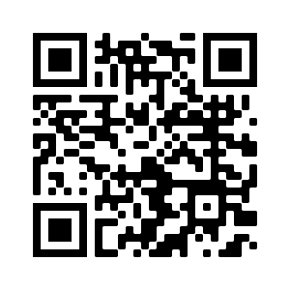
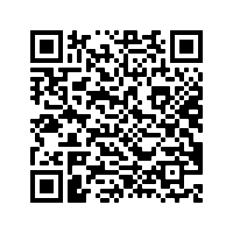
Who am I?
QR to my Pluralsight courses
Microsoft Certified Trainer
Author, Instructor, and Editor at Pluralsight, Develop Intelligence, and O’Reilly Media
AI and Cloud Consultant
QR to my O’Reilly trainings

Slide 17
Introduction
Overview of Apache Solr and Neural Search

Slide 18
Case Study: Looking for rentals
Rentals near bars
Search Engine
10000+ results

Slide 19
Case Study: Looking for rentals
+2-bedrooms +beer +”irish bar” -“times square”
Search Engine
102 results
None were exactly what she looked for!
You have to search through the list of results, maybe filter with a map (if such functionality exists)

Slide 20
Case Study: Looking for rentals
Neural Search comes to solve this!

Slide 21
What is Neural Search?
Applying NLP to this process
Enrich queries and indexes
Make the first query return the results with good precision and recall

Slide 22
Case Study: Looking for rentals
Rentals near bars
Search Engine
+
NLP
20 results

Slide 23
NLP Areas
Contextual Search: Synonyms, Autocomplete, Autocorrect
Machine Translation
Summarisation: Tag summarisation, phrase summarisation
Named Entity Recognition (NER)
Sentiment analysis
Q&A

Slide 24
Where can NLP help Search Engines?
Index time
Query
Indexing
Data
Results
Query time
Search Engine

Slide 25
Where can NLP help Search Engines?
Index time
Query
Reranked results
Enriched Results
Alternative Queries
Data
Indexing
NLP can help at every stage!!!
Query time
Search Engine

Slide 26
Where can NLP help Search Engines?
Synonym Expansion
Reranking results
Alternative Queries
NER
Data
4
Index
Search Engine
3
1
Query
Query
2

Slide 27

LAB: Interacting with PySolr
First interactions with PySolr
Environment Setup
Index the Airbnb dataset

Slide 28
Summary
Neural Search is the subject of using NLP techniques to search engines
We may use neural networks at index time, query time, or ranking time.
The main goal is to simplify life for users.

Slide 29
Discussion Time
Can you think of another use cases for NLP within your organisation?
Allocated time: 15 minutes

Slide 30
Break: 15 minutes

Slide 31
Word2Vec
Synonym expansion

Slide 32
Agenda
Introduction
Introductions
Expectations
Overview of Apache Solr
What is Neural Search?
Ranking
Doc2Vec
PD-DM and DBOW
Learning to Rank
NER
Scapy NER
BERT
Synonyms
Neural Networks
Word2vec
CBOW and Skip-Gram
Text Generation
RNN
GRU and LSTM
Transformers
Next Steps
Closing thoughts
Notes:
[Mandatory slide]
ACTION: Adjust as per your course.
The agenda provides students a roadmap of where the class is going and what is coming up. Keep it high level, as there is no need to include “Gazornin” in the agenda if that’s something they don’t understand. Refer to the agenda at the beginning of the class, at the end of every day and at the beginning of every morning. In the mornings the Agenda is a great way to facilitate a Q&A session about what was covered on the previous day.

Slide 33
What are we going to do now?
Synonym Expansion
Reranking results
Alternative Queries
NER
Data
4
Index
Search Engine
3
1
Query
Query
2

Slide 34
What are we going to do now?
Search Engine
Grape
Query
Grape fruit wine merlot napa
Synonyms increase the chances of returning the result the user wants

Slide 35
How do we represent words?
Spain
[1, 0 ]
Russia
[-1, 1 ]

Slide 36
How do we represent words?
Spain
Russia
Madrid??

Slide 37
How do we represent words?
Madrid
Spain
Russia
Madrid should be closer to Spain than Russia

Slide 38
How do we represent words?
This mapping, or function, from words to sequences of numbers is called a word representation or embedding.
If we have a good word representation, then we can find similar words! And use those synonyms to expand the query.
It has been shown that neural networks are great to find good embeddings

Slide 39
Neural Networks
[1,0,0]
[0,1,0]
Z2
Apply a function
X2
You and only you
[0,0,1]
[1,0,0]
Z2 = w1 * “you” + w2 * ”and” + w3* ”only” + w4 * “you”
This would create a 1 dimensional representation

Slide 40
Neural Networks
X2¹
[1,0,0]
X2²
[0,1,0]
This would create a 4 dimensional representation
You and only you
[0,0,1]
X2³
[1,0,0]
We represent each of the initial numbers as circles too and we get…
X2⁴

Slide 41
Neural Networks
Each input word is a circle, for convenience
Here we added another “layer” of doing the same, increasing complexity and prediction power

Slide 42
Neural Networks: Training

Slide 43
CBOW

Slide 44
Why we do this?
This way, we can later get those w that mapped the words into this n-dimensional representation. That is our embedding.
We used this trick with windows to be able to train it in an unlabelled fashion
It works incredibly well
EMBEDDING

Slide 45
LAB: Training CBOW
Train your first embedding using Keras
Transform text into a generator of training sequences
Allocated time: 30+ minutes (depending on Keras comfort level)

Slide 46
Pulse Check

Slide 47
Lunch Break: 45 minutes

Slide 48
Can we do better?
Researchers found that one can do many things to improve
As layers “stack up” one can reuse a pretrained model on the first layers and just train the rest.
Not only it speeds up, but makes it possible to do magic with little data
This is called fine-tuning

Slide 49
LAB: Using GloVe pre trained Embedding
Fine tune GloVe to our Airbnb dataset
Verify how easy it is!
Allocated time: 20 minutes

Slide 50
LAB: Synonym Expansion
Use our model to leverage synonyms in Solr
Allocated time: 15 minutes

Slide 51
Summary
Synonym expansion helps recall by expanding the query with synonyms of the nouns
This way, even if the user doesn’t input the correct term, it still gets the result
Under the hood is a word embedding to find similar words on a vocabulary.
Known word embedding models are CBOW and Skip-Gram

Slide 52
Mini Break: 5 minutes

Slide 53
Ranking
Doc2Vec

Slide 54
Agenda
Introduction
Introductions
Expectations
Overview of Apache Solr
What is Neural Search?
Ranking
Doc2Vec
PD-DM and DBOW
Learning to Rank
NER
Scapy NER
BERT
Synonyms
Neural Networks
Word2vec
CBOW and Skip-Gram
Text Generation
RNN
GRU and LSTM
Transformers
Next Steps
Closing thoughts
Notes:
[Mandatory slide]
ACTION: Adjust as per your course.
The agenda provides students a roadmap of where the class is going and what is coming up. Keep it high level, as there is no need to include “Gazornin” in the agenda if that’s something they don’t understand. Refer to the agenda at the beginning of the class, at the end of every day and at the beginning of every morning. In the mornings the Agenda is a great way to facilitate a Q&A session about what was covered on the previous day.

Slide 55
What are we going to do now?
Synonym Expansion
Reranking results
Alternative Queries
NER
Data
4
Index
Search Engine
3
1
Query
Query
2

Slide 56
What are we going to do now?
Query
Search Engine
Grape
Ranked results
Reranking allows to get the best documents first related to the dataset and query

Slide 57
How can we rank using NLP?
Search Engine
Beautiful condo close to wine shops in 5th avenue
1 Bedroom apartment in the heart of Brooklyn close to boutique with ancient wines
Wine wine wine wine wine wine
2-bedroom apartment midtown wine
Which one do you think Lucene returns as first?

Slide 58
Introducing Doc2Vec
Similarly to before, it would be good to have a function that maps a whole document into numbers
This way we could find similarity between the query and each result with respect to our specific dataset
This means that the same query and result would have different similarity on different datasets, which is what we want!

Slide 59
DBOW
Works surprisingly well!
Same as before, but assign an ID per document

Slide 60
PV-DM

Slide 61
LAB: Train DBOW using GenSim
Train a Doc2Vec model using GenSim
Allocated time: 20 minutes

Slide 62
Pulse Check

Slide 63
How can we rank using NLP?
Search Engine
Beautiful condo close to wine shops in 5th avenue
1 Bedroom apartment in the heart of Brooklyn close to boutique with ancient wines
Wine wine wine wine wine wine
2-bedroom apartment midtown wine
A Good Doc2Vec algorithm would find the first 2 more similar to the query
We reorder based on similarity!!

Slide 64
LAB: Reranking
Create a reranking algorithm in Solr
Allocated time: 15 minutes

Slide 65
Discussion Time
Which strategy do you think is best to “rank by relevance” the documents returned by a query?
Allocated time: 15 minutes

Slide 66
Summary
A way to rank documents is using doc2vec models
This way we get more similar results to what we wanted
However this is the start, after this step we could add an LTR model
Known doc2vec models are DBOW and PV-DM

Slide 67
End of Day 1

Slide 68
Text Generation
RNN

Slide 69
Agenda
Introduction
Introductions
Expectations
Overview of Apache Solr
What is Neural Search?
Ranking
Doc2Vec
PD-DM and DBOW
Learning to Rank
NER
Spacy
Synonyms
Neural Networks
Word2vec
CBOW and Skip-Gram
Text Generation
RNN
GRU and LSTM
Transformers
Next Steps
Closing thoughts
Notes:
[Mandatory slide]
ACTION: Adjust as per your course.
The agenda provides students a roadmap of where the class is going and what is coming up. Keep it high level, as there is no need to include “Gazornin” in the agenda if that’s something they don’t understand. Refer to the agenda at the beginning of the class, at the end of every day and at the beginning of every morning. In the mornings the Agenda is a great way to facilitate a Q&A session about what was covered on the previous day.

Slide 70
What are we going to do now?
Synonym Expansion
Reranking results
Alternative Queries
NER
Data
4
Index
Search Engine
3
1
Query
Query
2

Slide 71
What are we going to do now?
Search Engine
Grape
Query
Grape I would like rentals close to vineyards
Alternative Queries simplifies the task for the user, the whole phrase is created by the NN

Slide 72
How do we generate text?

Slide 73
How do we generate text?

Slide 74
Problems
If we used a normal NN, we would need a window of fixed size to predict the next character/word
But in text, sometimes the core meaning comes at the end, however long it is the sequence.
“Hospitals are sued by 7 foot doctors”
Local high school dropouts cut in half
These problems are and for normal NN because they cannot remember!

Slide 75
Character level text generation “passing memory”
The “key” is to pass the state as input to remember

Slide 76
Recursive Neural Networks
X2¹
[1,0,0,0]
X2²
Y¹
[0,1,0,0]
[0,0,0,1]
Y O U
R
[0,0,1,0]
X2³

Slide 77
Recursive Neural Networks

Slide 78
Variations of RNNs
These extra gates provide memory and forgetfulness

Slide 79
LAB: Train an RNN
Train an RNN from scratch
Put attention to the dataset preparation and how to predict
Allocated time: 30/45 minutes

Slide 80
Pulse Check

Slide 81
Break: 10 minutes

Slide 82
LAB: Alternative Queries
Create alternative queries in Solr with our model
Allocated time: 15 minutes

Slide 83
Discussion Time
Why do you think the model performed as it did? Any idea to improve it?
Allocated time: 10 minutes

Slide 84
A note on Transformers

Slide 85
A note on Transformers
They act as black boxes that perform sequence-sequence tasks, such as text generation
A transformer

Slide 86
Bigger vs Better

Slide 87
Beware of $$$

Slide 88
LAB: Using Transformers
Use GPT-2 to generate the query expansion
Allocated time: 20 minutes

Slide 89
A note on Transfer Learning

Slide 90
Discussion Time
I leave you as homework to use transfer learning on our GPT-2 text generation to improve it further with the Airbnb context

Slide 91
Summary
Using text generation we can generate alternative queries to run
This way we can make the task easier for users by allowing them to be lazy
Under the hoods, we need a model with recursive structure to maintain memory of the state
Using pre-trained transformers may help a lot on your task
If we have time at the end, we can discuss about distillation! (Please remind me)

Slide 92
NER
NER

Slide 93
Agenda
Introduction
Introductions
Expectations
Overview of Apache Solr
What is Neural Search?
Ranking
Doc2Vec
PD-DM and DBOW
Learning to Rank
NER
Spacy
Synonyms
Neural Networks
Word2vec
CBOW and Skip-Gram
Text Generation
RNN
GRU and LSTM
Transformers
Closing Thoughts
Notes:
[Mandatory slide]
ACTION: Adjust as per your course.
The agenda provides students a roadmap of where the class is going and what is coming up. Keep it high level, as there is no need to include “Gazornin” in the agenda if that’s something they don’t understand. Refer to the agenda at the beginning of the class, at the end of every day and at the beginning of every morning. In the mornings the Agenda is a great way to facilitate a Q&A session about what was covered on the previous day.

Slide 94
What are we going to do now?
Synonym Expansion
Reranking results
Alternative Queries
NER
Data
4
Index
Search Engine
3
1
Query
Query
2

Slide 95
What are we going to do now?
Search Engine
Data
Enrichment
Enriched Document to Index
NER helps extract useful tags from text and have only those enriches fields be indexable and retrievable, making the index more efficient.

Slide 96
Named Entity Recognition
All of these tags extract information from the text

Slide 97
Named Entity Recognition
All of these tags extract information from the text

Slide 98
Bi-LSTM
We need a forward and backward pass because some tags at the beginning only make sense after reading the whole sentence

Slide 99
Spacy

Slide 100
LAB: Enriching documents with NER
Create a tags field with NER extracted tags
Verify most useful queries still work
Allocated time: 20 minutes

Slide 101
Pulse Check

Slide 102
Discussion Time
Do you have any use cases where NER may help you?

Slide 103
Break: 15 minutes

Slide 104
Bonus Labs
Feel free to use the remaining time to revisit the old core labs
Or enjoy the 3 extra labs covering some extra topics that relate (LTR, Bi-LSTM on Sentiment, and Bi-LSTM on NER)
I will be here for any questions!

Slide 105
Please Fill in Survey

Slide 106
THANK YOU
Notes:
[Mandatory Slide]
ACTION: Use this for the final slide of your class materials

